Slide 1
EFFECTS OF CONTINUING COVID-19 EFFECTS ON MENTAL HEALTH REGARDING DEPRESSIVE AND ANXIETY DISORDERS
By Eric Cartaya

Slide 2
Introduction
With the current Covid-19 crisis mental health issues have seen a rise in the United States, especially across disadvantaged groups such as minorities and those with less education. For this reason the focus of this project is on the different subgroups across the United States and how mental illness is affecting them.
The data comes for the Household Pulse Survey as part of a joint effort of the CDC and the Census Bureau. Whilst it looked at many aspects of American life and how it has been affected by the pandemic the aspect that this presentation focuses on is the mental health situation of Americans.
This presentation and the accompanying report look specifically of the overall increase in mental illness, which groups is it primarily affecting, and in which groups is it increasing in most rapidly.

Slide 3
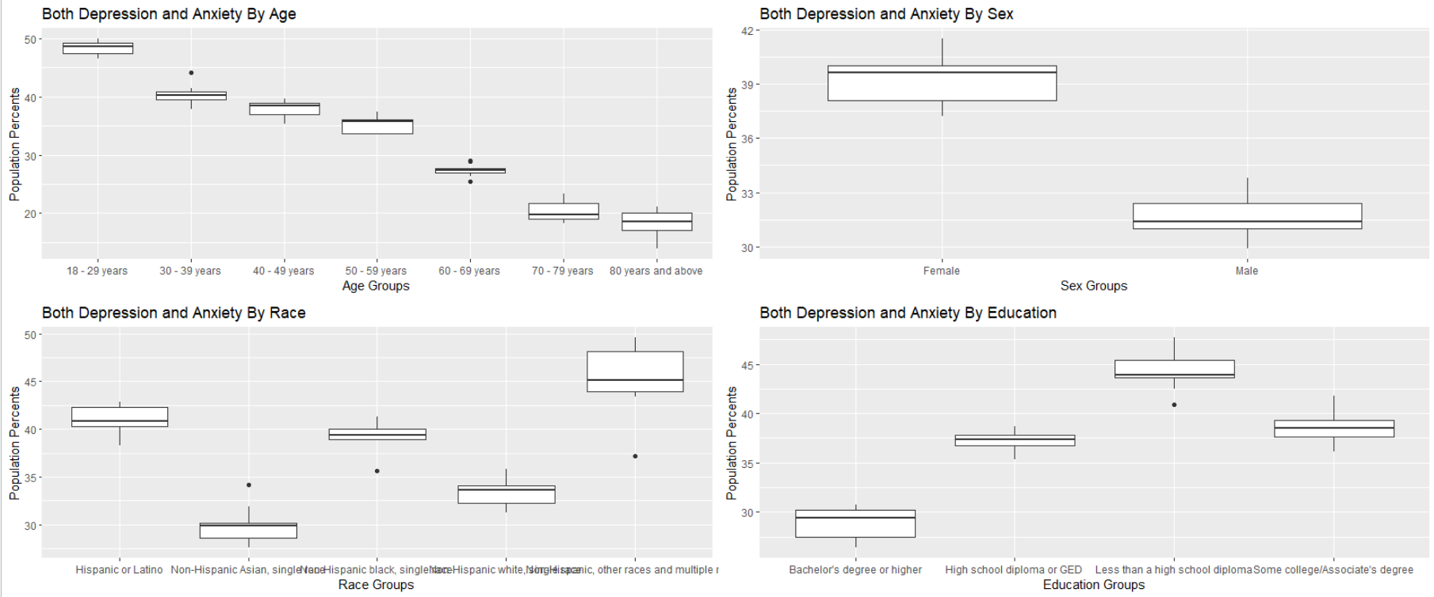
Initial Overlook and
In all of the different groups the Value Variable (which was the percent of the sample with mental illness) is displayed in boxplot form. This shows some of the group based trends and gives immediate context to the nature of the study.
Looking at this we can see that the 18-29 age group, the mixed race group, the female sex group, and the no-high-school-diploma group are at the most risk of mental illness.
The objective is to figure out if the more at risk groups are SIGNIFICANTLY different or if they only appear different from the rest of the groups. This primarily utilized the T^2 Test. Both tests were used more as a method of double checking.

Slide 4
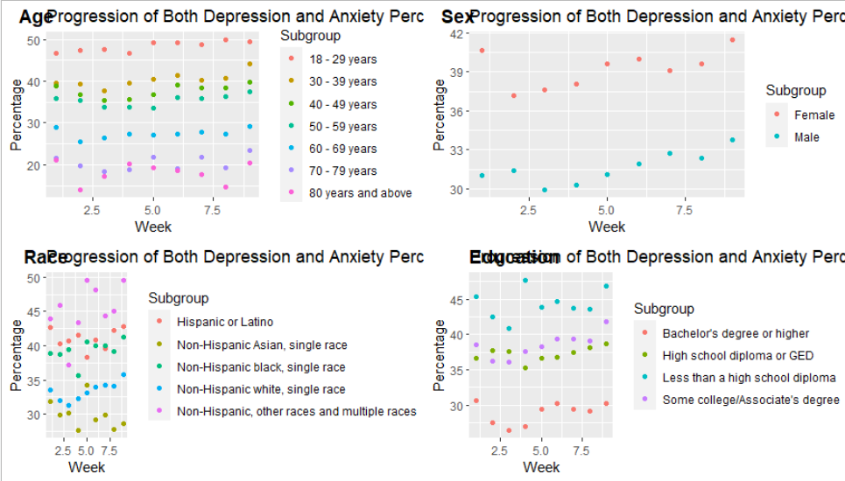
The Progression of Mental Health
The progression of mental health was first observed using the following scatter plots.
They indicate not only the groups that have been more affected but how susceptible some groups have been to changing conditions. Whilst the younger groups in Age are more ill, they are far more stable that the 70-79 and 80 and above groups.
All groups (except for the Asians) give an indication that the mental health in the nation is getting worse and among individual groups the mental health continues to get worse.
Through the models produced we can get a better idea of how the disease has progressed over time.

Slide 5
The Models of Mental Health
> summary(or_nat_model)
Call: glm(formula = Value ~ Week, data = or_nation_table)
Deviance Residuals: Min 1Q Median 3Q Max
-1.0322 -0.3906 -0.1789 0.2328 1.5911
Coefficients: Estimate Std. Error t value Pr(>|t|)
(Intercept) 33.9972 0.6598 51.526 2.72e-10 ***
Week 0.3117 0.1173 2.658 0.0326 *
--- Signif. codes: 0 ‘***’ 0.001 ‘**’ 0.01 ‘*’ 0.05 ‘.’ 0.1 ‘ ’ 1
(Dispersion parameter for gaussian family taken to be 0.8248651) Null deviance: 11.6022 on 8 degrees of freedom
Residual deviance: 5.7741 on 7 degrees of freedom AIC: 27.546
Number of Fisher Scoring iterations: 2
> summary(or_age_model)
Call: glm(formula = Value ~ Week + Subgroup, data = or_age_table)
Deviance Residuals: Min 1Q Median 3Q Max
-4.2392 -0.7918 -0.0187 0.9137 4.0375
Coefficients: Estimate Std. Error t value Pr(>|t|)
(Intercept) 47.08651 0.63313 74.371 < 2e-16 ***
Week 0.25381 0.07479 3.394 0.00128 **
Subgroup30 - 39 years -7.96667 0.72252 -11.026 1.5e-15 ***
Subgroup40 - 49 years -10.65556 0.72252 -14.748 < 2e-16 ***
Subgroup50 - 59 years -13.04444 0.72252 -18.054 < 2e-16 ***
Subgroup60 - 69 years -20.93333 0.72252 -28.973 < 2e-16 ***
Subgroup70 - 79 years -27.96667 0.72252 -38.707 < 2e-16 ***
Subgroup80 years and above -30.27778 0.72252 -41.906 < 2e-16 ***
--- Signif. codes: 0 ‘***’ 0.001 ‘**’ 0.01 ‘*’ 0.05 ‘.’ 0.1 ‘ ’ 1
(Dispersion parameter for gaussian family taken to be 2.349162) Null deviance: 6717.6 on 62 degrees of freedom
Residual deviance: 129.2 on 55 degrees of freedom AIC: 242.04
Number of Fisher Scoring iterations: 2
> summary(or_sex_model)
Call: glm(formula = Value ~ Week + Subgroup, data = or_sex_table)
Deviance Residuals: Min 1Q Median 3Q Max
-1.14917 -0.84021 -0.07278 0.57847 2.65667
Coefficients: Estimate Std. Error t value Pr(>|t|)
(Intercept) 37.73750 0.60213 62.673 < 2e-16 ***
Week 0.30583 0.09725 3.145 0.00668 **
SubgroupMale -7.65556 0.50221 -15.244 1.55e-10 ***
--- Signif. codes: 0 ‘***’ 0.001 ‘**’ 0.01 ‘*’ 0.05 ‘.’ 0.1 ‘ ’ 1
(Dispersion parameter for gaussian family taken to be 1.134987) Null deviance: 291.983 on 17 degrees of freedom
Residual deviance: 17.025 on 15 degrees of freedom AIC: 58.079
Number of Fisher Scoring iterations: 2
> summary(or_race_model)
Call: glm(formula = Value ~ Week + Subgroup, data = or_race_table)
Deviance Residuals: Min 1Q Median 3Q Max
-7.6120 -0.8782 0.1431 0.9573 4.3667
Coefficients: Estimate Std. Error t value Pr(>|t|)
(Intercept) 39.9467 0.9788 40.814 < 2e-16 ***
Week 0.2107 0.1281 1.644 0.108231
SubgroupNon-Hispanic Asian, single race -11.0778 1.0463 -10.587 4.96e-13 ***
SubgroupNon-Hispanic black, single race -1.7111 1.0463 -1.635 0.110024
SubgroupNon-Hispanic white, single race -7.6111 1.0463 -7.274 9.04e-09 ***
SubgroupNon-Hispanic, other races and multiple races 4.2333 1.0463 4.046 0.000239 ***
--- Signif. codes: 0 ‘***’ 0.001 ‘**’ 0.01 ‘*’ 0.05 ‘.’ 0.1 ‘ ’ 1
(Dispersion parameter for gaussian family taken to be 4.926646) Null deviance: 1548.46 on 44 degrees of freedom
Residual deviance: 192.14 on 39 degrees of freedom AIC: 207.02
Number of Fisher Scoring iterations: 2
> summary(or_ed_model)
Call: glm(formula = Value ~ Week + Subgroup, data = or_ed_table)
Deviance Residuals: Min 1Q Median 3Q Max
-2.9283 -0.7917 -0.1025 0.6494 3.6025
Coefficients: Estimate Std. Error t value Pr(>|t|)
(Intercept) 27.55417 0.69558 39.613 < 2e-16 ***
Week 0.26917 0.09677 2.782 0.00912 **
SubgroupHigh school diploma or GED 8.33333 0.70671 11.792 5.44e-13 ***
SubgroupLess than a high school diploma 15.46667 0.70671 21.885 < 2e-16 ***
SubgroupSome college/Associate's degree 9.56667 0.70671 13.537 1.48e-14 ***
--- Signif. codes: 0 ‘***’ 0.001 ‘**’ 0.01 ‘*’ 0.05 ‘.’ 0.1 ‘ ’ 1
(Dispersion parameter for gaussian family taken to be 2.247478) Null deviance: 1183.708 on 35 degrees of freedom
Residual deviance: 69.672 on 31 degrees of freedom AIC: 137.93
Number of Fisher Scoring iterations: 2
The models to the right (messily) shows the progression of each of the values over time as compared to the ‘base’ subgroup for each group. These ‘base’ subgroups are : 18-29 years old, females, Hispanics/Latinos, and people who have acquired a college degree.
Actual models show more the influence of the mean of the variables rather than the change over time for each of the subgroups. This is a failure of the project and a possible improvement that could be made to it in the future.
We can however see that there is a steady increase over time across the nation indicating to the worsening of the mental health situation in the United States.

Slide 6
The Difference in Means
T2.test(or_age_table2)# Hotelling's T2 test
One-sample Hotelling test data: or_age_table2 T2 = 53600.2, F = 1914.3, df1 = 7, df2 = 2, p-value = 0.0005222
alternative hypothesis: true mean vector is not equal to (0, 0, 0, 0, 0, 0, 0)'
sample estimates: 18 - 29 years 30 - 39 years 40 - 49 years 50 - 59 years 60 - 69 years 70 - 79 years 80 years and above
mean x-vector 48.35556 40.38889 37.7 35.31111 27.42222 20.38889 18.07778
T2.test(or_sex_table2)
One-sample Hotelling test data: or_sex_table2 T2 = 7846.3, F = 3432.8, df1 = 2, df2 = 7, p-value = 3.372e-11
alternative hypothesis: true mean vector is not equal to (0, 0)'
sample estimates: Female Male
mean x-vector 39.26667 31.61111
T2.test(or_race_table2)
One-sample Hotelling test data: or_race_table2 T2 = 21938.2, F = 2193.8, df1 = 5, df2 = 4, p-value = 5.811e-07
alternative hypothesis: true mean vector is not equal to (0, 0, 0, 0, 0)'
sample estimates: Hispanic or Latino; Non-Hispanic Asian, single race; Non-Hispanic black, single race; Non-Hispanic white, single race; Non-Hispanic other races and multiple races
mean x-vector 41 29.92222 39.28889 33.38889 45.23333
T2.test(or_ed_table2)
One-sample Hotelling test data: or_ed_table2 T2 = 46599.9, F = 7281.2, df1 = 4, df2 = 5, p-value = 1.351e-09
alternative hypothesis: true mean vector is not equal to (0, 0, 0, 0)'
sample estimates: Bachelor's degree or higher High school diploma or GED Less than a high school diploma Some college/Associate's degree
mean x-vector 28.9 37.23333 44.36667 38.46667
In an effort to check the significant difference in means two methods were used. The first (shown here) is the T^2 test to indicate that the samples shown are significantly different from each other.
Here it can be seen that in every case we may reject the Null Hypothesis that all of the populations are the same and thus they are significantly different from one another. This is also used to indicate that the means are significantly different as well.
This method was primarily chose as it shows the different means of each and displays them to indicate further that they differ significantly from one another.

Slide 7
Anova and Kruskal-Wallis
> anova(or_age_model)
Analysis of Deviance Table
Model: gaussian, link: identity
Response: Value Terms added sequentially (first to last)
Df Deviance Resid. Df Resid. Dev
NULL 62 6717.6
Week 1 27.1 61 6690.5
Subgroup 6 6561.3 55 129.2
> aov(Value ~ Week + Subgroup, data = or_age_table)
Call: aov(formula = Value ~ Week + Subgroup, data = or_age_table)
Terms: Week Subgroup Residuals
Sum of Squares 27.056 6561.323 129.204
Deg. of Freedom 1 6 55
Residual standard error: 1.532698
Estimated effects may be unbalanced
> summary(aov(Value ~ Week + Subgroup, data = or_age_table))
Df Sum Sq Mean Sq F value Pr(>F)
Week 1 27 27.1 11.52 0.00128 **
Subgroup 6 6561 1093.6 465.51 < 2e-16 ***
Residuals 55 129 2.3
--- Signif. codes: 0 ‘***’ 0.001 ‘**’ 0.01 ‘*’ 0.05 ‘.’ 0.1 ‘ ’ 1
> kruskal.test(anova(or_age_model))
Kruskal-Wallis rank sum test
data: anova(or_age_model)
Kruskal-Wallis chi-squared = 6.8545, df = 3, p-value = 0.07668
This slide and the next will focus primarily on the Age Model as it has several subgroups with shorter names and displaying the whole of the entire dataset would be problematic. For the reasons of space and time this has been deemed necessary.
The Anova was performed more as a way of checking to see that nothing was strange behind the scenes in each of the models. Nothing stood out of the ordinary in this or any other of the models.
The Kruskal-Wallis test was then performed using the Anova (the secondary reason to do the Anova) as this was one of the required tests and the one that would answer the main question related to the difference in means. Unfortunately due to the ineffectual design of the model (partly due to a poor design of the data) this test is not very useful.

Slide 8
Clustering and Cluster Analysis
Looking through the clusters we begin to see both the levels and the trends in more clear terms. Two different cluster structures were used as different attempts to capture which number of cluster should use resulted in 3 clusters and 5 cluster, thus they were both used. Both used k-means.
Through both of these we can get some interesting observations, such as the higher distributions of the at risk groups (young adults pictured here) and get an indication of which groups have been changing the most (such as the elderly).
The cluster table was used over the cluster diagram mostly due to readability and the fact that the cluster table gave more interesting indications.
> aggregate(or_age_table3, by = list(fit1$cluster), FUN = mean)
Group.1 18 - 29 years 30 - 39 years 40 - 49 years 50 - 59 years 60 - 69 years 70 - 79 years 80 years and above
1 1 47.15 38.65 35.50 33.70 26.90 18.55 18.60
2 2 48.70 41.22 38.58 35.72 28.02 21.46 19.40
3 3 48.70 40.05 37.70 35.90 26.45 19.55 14.25
> aggregate(or_age_table3, by = list(fit2$cluster), FUN = mean)
Group.1 18 - 29 years 30 - 39 years 40 - 49 years 50 - 59 years 60 - 69 years 70 - 79 years 80 years and above
1 1 47.15 38.65 35.5 33.70000 26.90000 18.55 18.60000
2 2 46.80 39.60 38.9 35.80000 28.90000 21.50 21.10000
3 3 49.40 44.10 39.7 37.40000 29.10000 23.40 20.50000
4 4 48.70 40.05 37.7 35.90000 26.45000 19.55 14.25000
5 5 49.10 40.80 38.1 35.13333 27.36667 20.80 18.46667

Slide 9
Conclusions
The three hypothesis will be covered one by one.
The hypothesis that mental illness is worsening in the United States during the Covid-19 crisis could not be rejected. This leads into the idea that as fear of the virus, social isolation, and the accompanying unrest continues symptoms of depression and anxiety will continue to become more widespread. This conclusion was derived from the significant linear trend between the progression of the weeks and the notable increase in symptoms.
The hypothesis that certain groups are more significantly effected than others could not be rejected in any case. Using Hotelling’s T^2 and cluster analysis we can clearly see that young people, racial minorities, those with less formal education, and women are all at greater risk of mental illness during this time. The only discrepancy is that this element of the data is the most susceptible to sampling bias and other related sampling issues. Whilst the data comes from the CDC and seems to be very well research it is important to note.
The hypothesis that certain groups are becoming more susceptible to mental illness over time was inconclusive. The models created to study this effect were ineffective and suffered from incorrect design. Through this we cannot learn if the people of the United States are truly becoming more ill at different rates depending on subgroup. There are no formal conclusions that can be made about this portion of the assignment.

Slide 10
The Future of this Research
This data was not meant to be analyzed in this way or presented as such, and the decision to use this data for this assignment was a poor one. The dataset gives a percentage of the sample with the symptoms of mental illness, subdividing the data in several different fashions without showing how any of the data overlaps. It doesn’t indicate “College Degree and Hispanic” or “Over 80 and Female”, it merely indicate the percentages over time for the one general statistic. This tells a lot about how the country is progressing in different aspects and how different groups are being affected overall, but without the original dataset (which I could not find) this data is very limited in what it could tell us. The time that I was able to work on both parts of the project was severely limited by outside forces and prevented a more in depth analysis.
If this project were to continue a new search for the complete dataset would have to be conducted. A more in depth model would have to be made and who truly has it the worst in the United States at the current moment would have to be investigated.
As for the broader impact this project has show that there are significant cracks in the mental health of the United States and possibly indicates that there are groups who do not have access to the resources they need to keep sane in this crisis.

